Slide 1



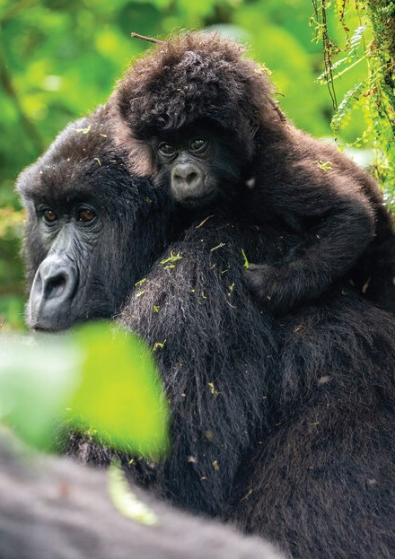
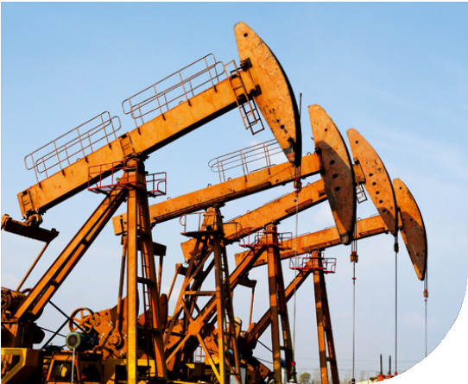

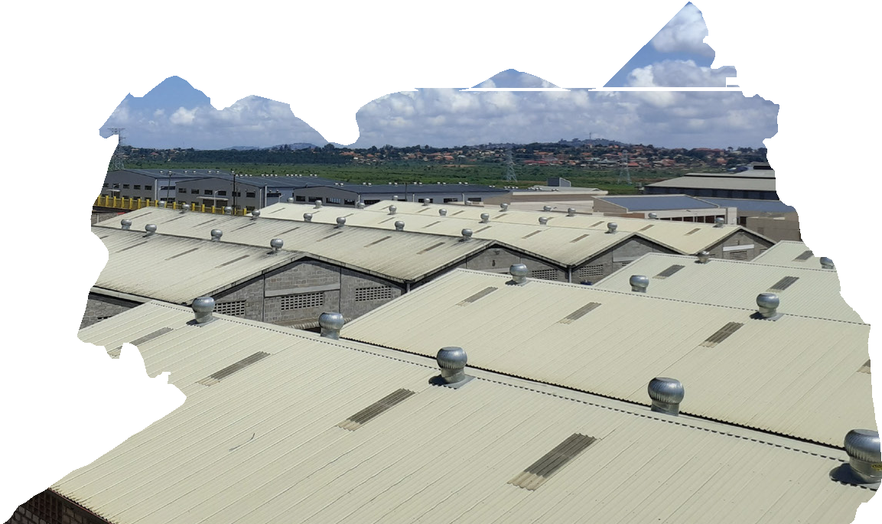


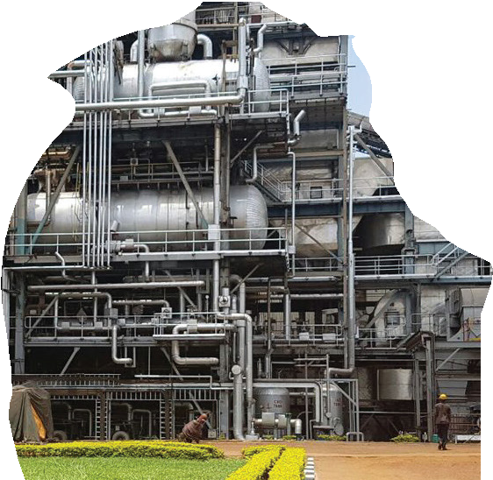

INVESTING IN UGANDA

Slide 2
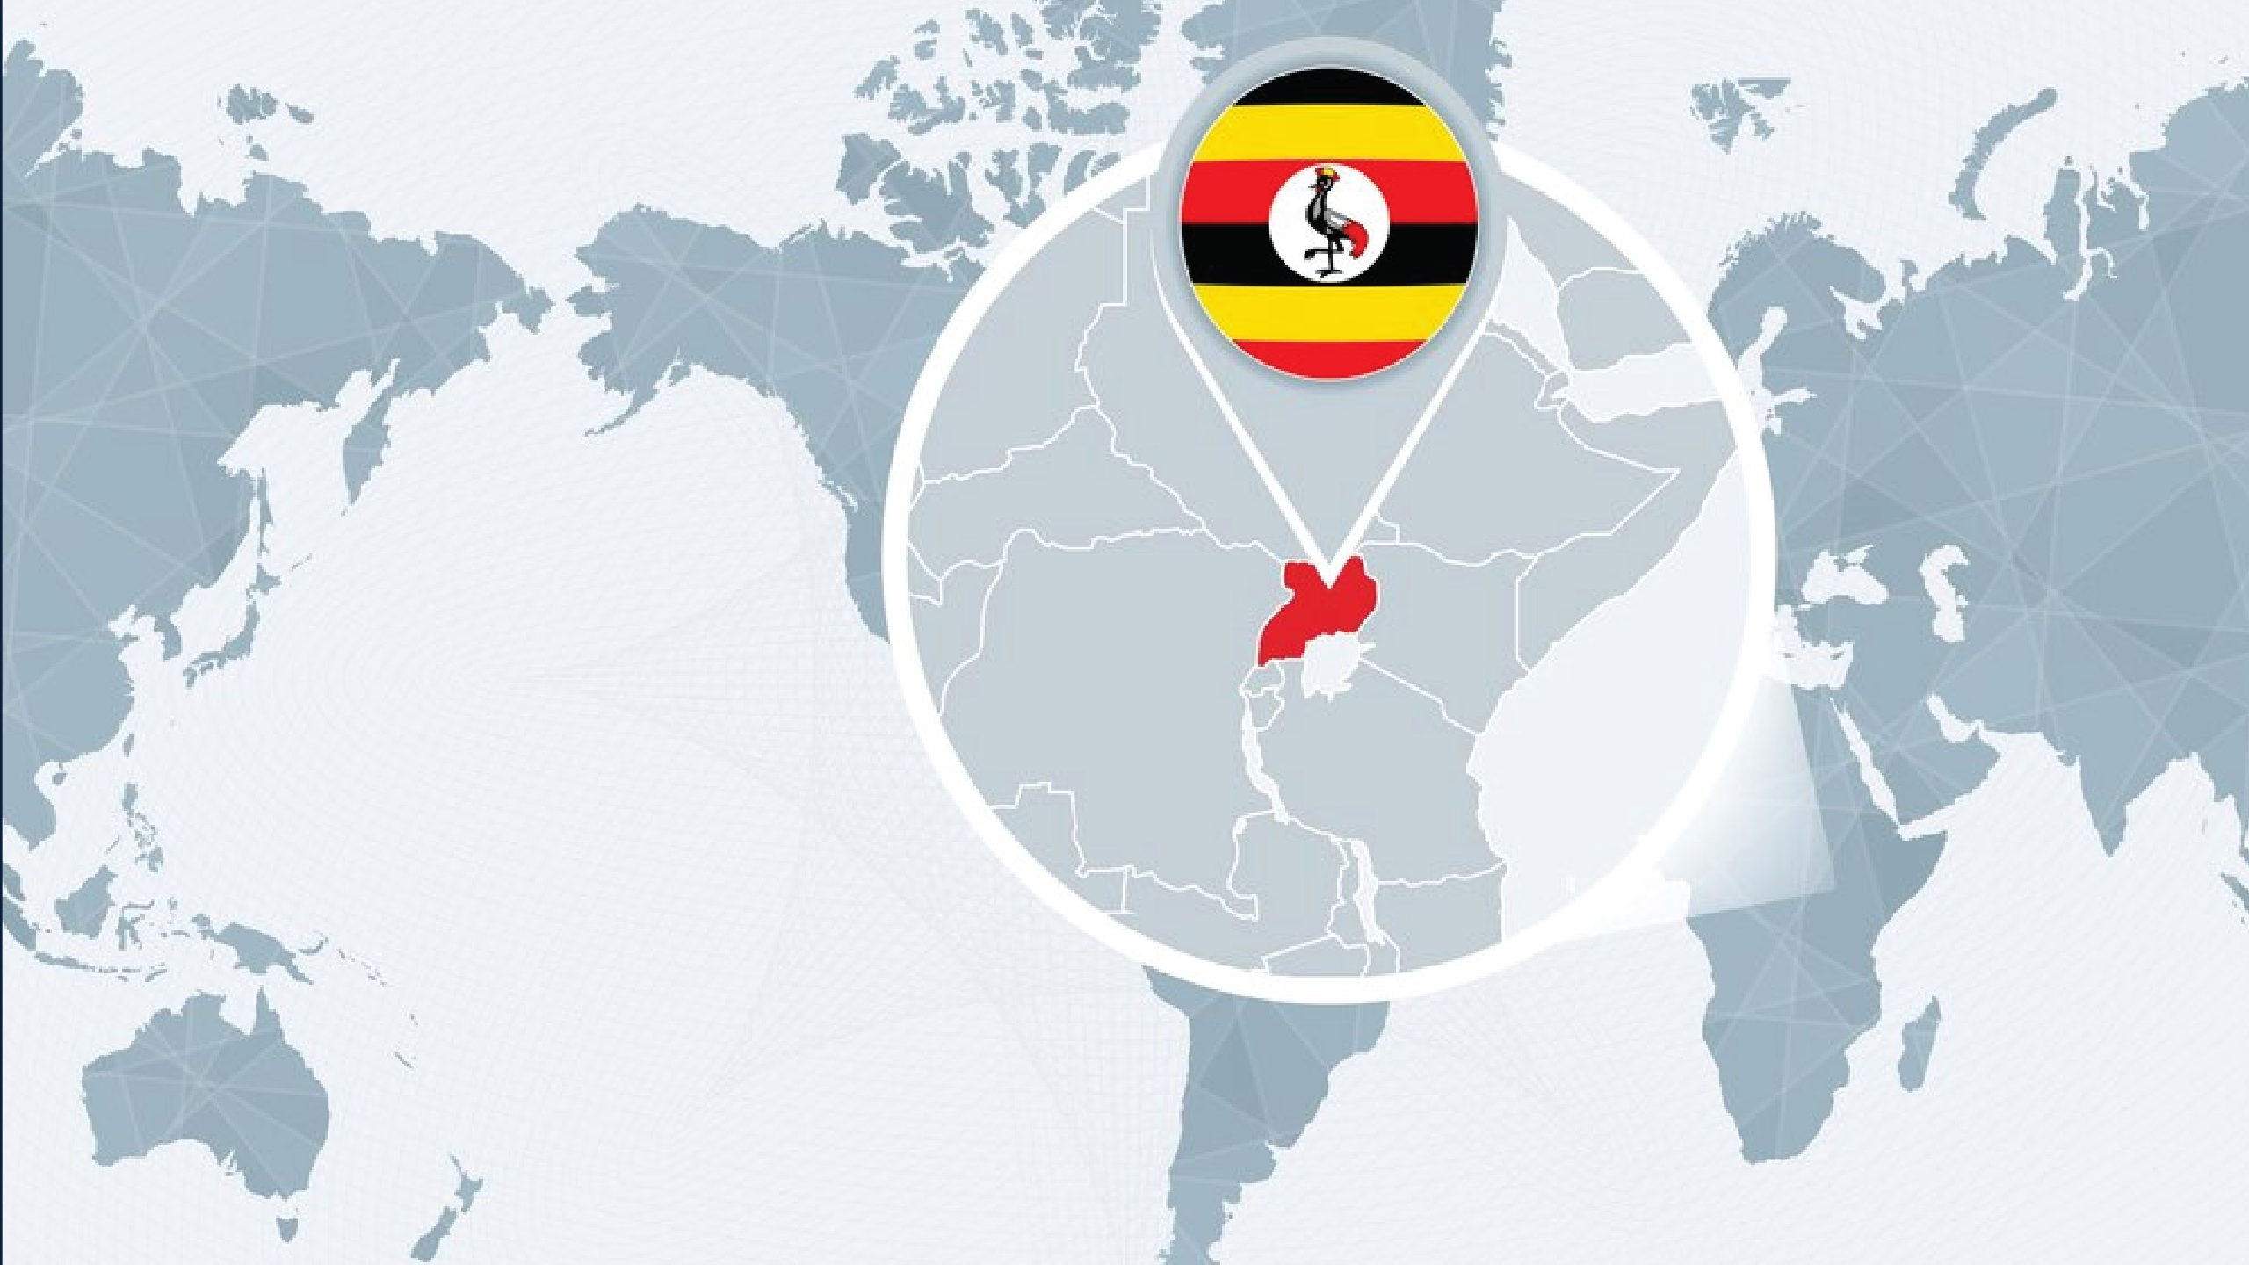





World’s longest River (River Nile)
Member of the East African Community (EAC )
Largest lake in Africa (Lake Victoria)

Slide 3













....Fly to Uganda

Slide 4



Role of Uganda Investment Authority
Promote / Market
Investment Opportunities
Investment Facilitation
Identify and promote strategic investment opportunities in Uganda to attract foreign and Domestic investments
Business support; Investor Licensing, Assist with government agencies, aftercare services, resolve investor issues, support diversification, and enable business linkages
UIA
One Stop Centre Services
Industrial Park Development
Ease doing business, through physical and virtual services (licensing and permits) to investors
Setup and manage Industrial and Business Parks.

Slide 5


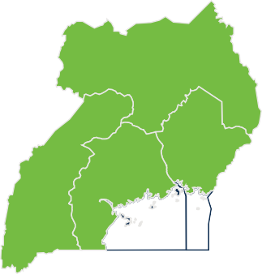


Why Uganda?
100% ownership of projects is allowed for foreign companies
Security of person and property is guaranteed
61 billion
GDP
3.3%
Inflation
6.3%
GDP growth rate
Top 10 in industrial development (Africa Development Bank (AfDB) Africa Industrialization Index 2022)
Land Linked- Kenya, Tanzania, Rwanda, South Sudan, and DRC

Slide 6


Why Uganda?
ANALYSIS OF UIA LICENSED PROJECTS ATTRACTING FDI FOR THE LAST 5 FYs (2020/21 – 2024/25)
FOREIGN DIRECT INVESTMENT(FDI)
FRANCE
INDIA CHINA
CAYMAN ISLANDS UK
MAURITIUS SINGAPORE RUSSIA UAE
H - Transportation and storage
A - Agriculture, forestry and fishing
C - Manufacturing
B - Mining And Quarrying
M - Professional, scientific and technical activities
L - Real estate activities
USD3.3 billion
FDI inflow
D - Electricity, gas, steam and air conditioning supply
J - Information and communication
S - Other service activities
F - Construction
2%
4% _{2%}
2%
2%
2%
2%
Top 10 sectors
hosting FDI
6%
5%
4%
5%
7%
36%
37%
7%
11%
Top ten countries hosting FDI
32%
17%
17%
Figure 1: Top 10 Sectors attracting FDI
Figure 2: Top 10 countries attracting FDI

Slide 7




Why Uganda?
TAX POLICY
30%
Corporate tax.
10%-40%
PAYE depending on
income earned.
18%
VAT
Import duty:
Finished Goods 25%,
intermediate, 10%
Raw materials:
Duty Free
Exemption from Corporate tax-
USD10million

Slide 8




Why Uganda?
BUSINESS
Large Domestic, Regional and Global Markets (Quota and Tariff free)
-Uganda - 45.9Mm people
-East African Community - 300m
people
-COMESA - 600m people
-AFCTA - 1.3bn people, in 54 countries with combined GDP valued at $ 3.4 Trillion
-EBA(Everything except Arms)- EU Trade Agreements with China.
Repatriation of profits is allowed.
100% Foreign ownership
11 operational Industrial parks.
youngest population globally, with an average age of 16.7 years and 75% under 30 years offering a large, energetic, and trainable workforce
Highest adult literacy in EAC, workforce aged 15-24 about 90% ( Source: Knoema)
2nd most biodiverse country in Africa 2020 (Source UBF).
Green investment and

Slide 9
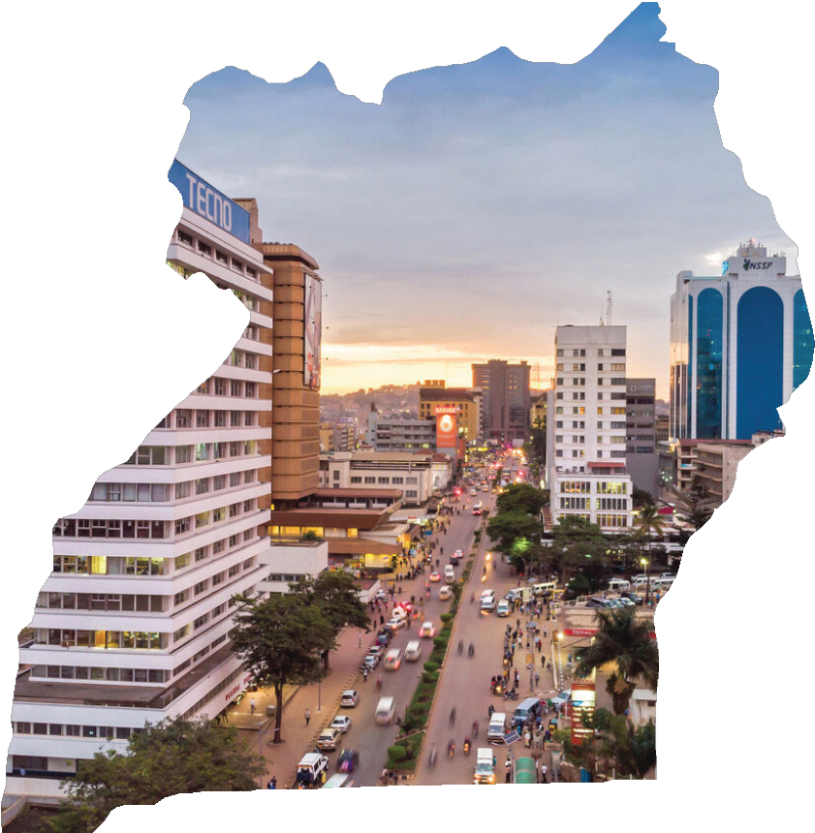


Global recognitions
Best tourist destination in the world (CNN, 2023)
Number 1, Regional leader in Capital Markets Growth. ( Absa Africa, Financial Markets Index, 2022)
Number 1, Happiest Country in the East African Region
( Happiest Index Score, 2022)

Slide 10
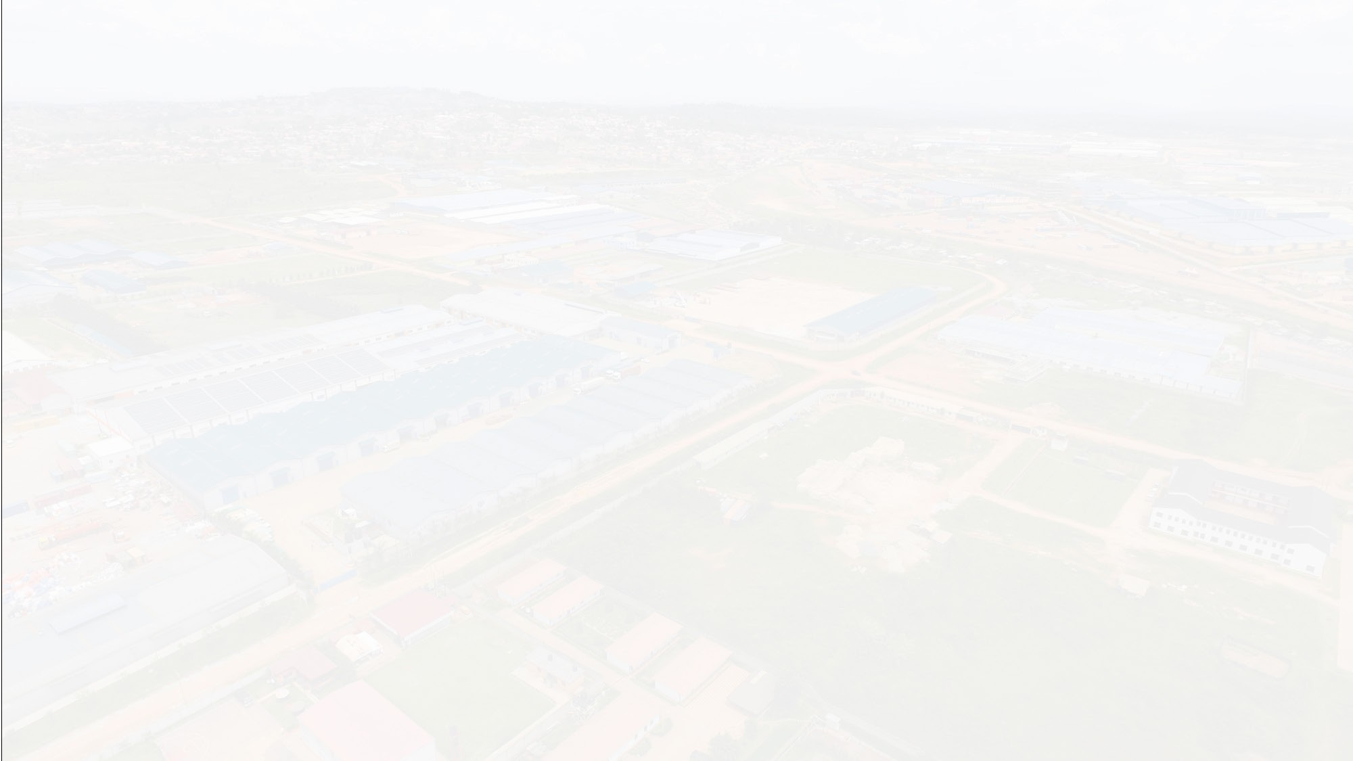







Award for the Greatest 'lnvestment Catalyst' in the world.Go Global Awards in Rhode Island USA
3rd most rewarding economy to invest in Africa Africa risk reward index 2023
- Oxford Economics
Best investment destination in East Africa (Annual Investment Meeting Awards- Abu Dhabi 2023)
Best investment destination in Africa (Annual Investment Meeting Awards Abu Dhabi 2024)
Award for sustainability lnvestment Promotion (WAIPA Excellence Awards- Saudi Arabia 2024)
2nd Best Investment Promotion Agency in Africa (Annual Investment Meeting Awards
-Abu Dhabi 2025)
Prestigious Greenfield Foreign
Direct Investment Award
Go Global Awards 2025 .
-London, United Kingdom.

Slide 11


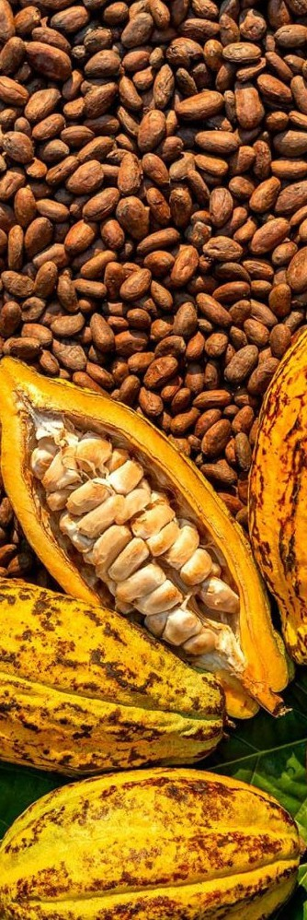

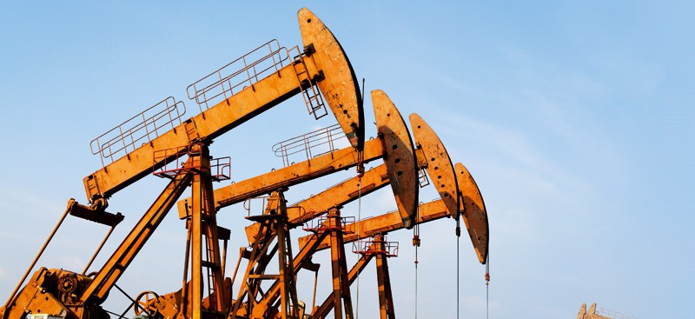
Investment Opportunities at a Glance
Oil and gas
Commercial Agriculture Agro-processing & Agribusiness
Tourism & Accomodation
Real Estate Development
Manufacturing / Industrialisation
Minerals
Health sector

Slide 12



AGRICULTURE VALUE ADDITION
Bankable Projects
Luwero fruit factory
Soluble Coffee Processing Factory.
Proposed Investment:
9.7Million USD
01
Proposed Investment:
48.1 million USD (Capex)
+ 33.89 million USD (Annual Opex)
02
Cocoa Processing Factory
Lira Cotton Spinning Mill
Proposed Investment:
24.3 Million USD
03
Proposed Investment:
44.34 million USD
04

Slide 13

MINERALS SECTOR
Moroto Integrated Cement,
Sheet Glass Manufacturing
Iron and Steel Manufacturing
Lime, and Marble
Manufacturing Factory.
Factory
Factory
Proposed Investment:
105.5 Million USD
Proposed Investment:
44.6 Million USD
Proposed Investment:
53 Million USD
01
02
03

Slide 14

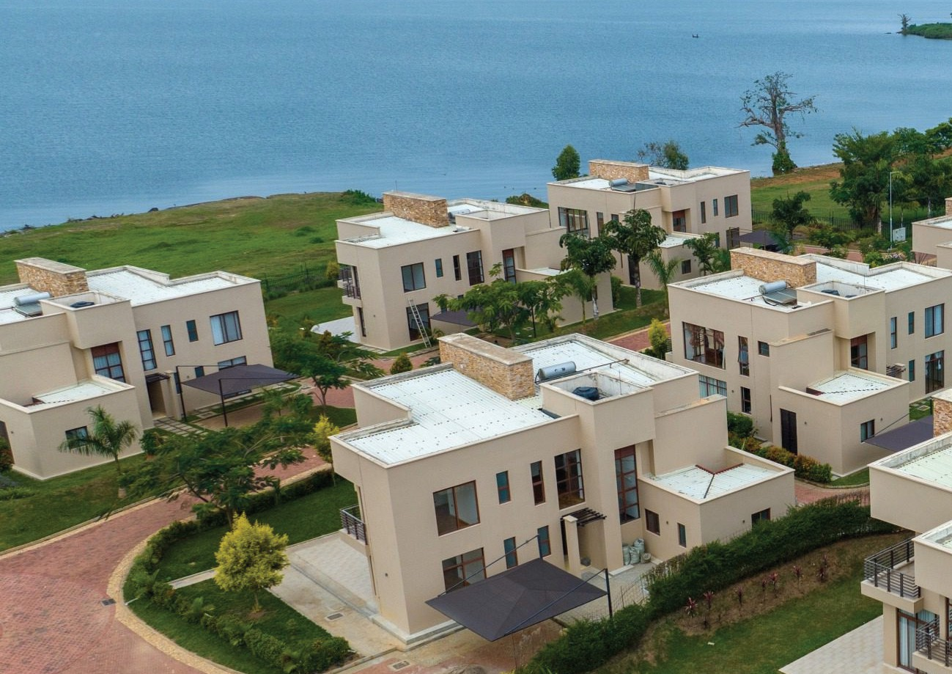


REAL ESTATE DEVELOPMENT
HEALTH SECTOR
East African Medical Vitals
Pearl Marina Estates
Proposed Investment:
18 Million USD
Proposed Investment:
10 – 45Million USD
01
01

Slide 15

Bankable Projects
TOURISM &
ACCOMODATION
Mount Elgon National Park
Tourism Infrastructure
Development Project.
Development of Tourist
Infrastructure at Equator
Points.
Development of Water-Based
Eco-Adventure Parks (Geothermal Spas & Resorts)
Proposed Investment:
79 Million USD
Proposed Investment:
8.7Million USD
Proposed Investment:
23.9Million USD
01
02
03
Nzururu Heights Hotel .
UWEC Infrastructure
Development Project.
Proposed Investment:
40Million USD
Proposed Investment:
15.6Million USD
04
05

Slide 16












Key Incentives
Agricultural Sector
10 years Tax Holiday for Agro processors operating in industrial park, free zone (export oriented)
Manufacturing Sector
10 years income tax holiday for exporters of finished consumer and capital goods (80% of production) outside domestic market.
VAT is exempt on raw materials.
Tourism
Tourism specific vehicles are exempt from import taxes.
Hotel equipment , fixtures and furniture are exempt from taxes at importation.
0% import duty on importation of Plant and Machinery for use in Agro Processing.
VAT is exempt on Accommodation in tourist hotels and lodges located up-country.
VAT deferment on plant and machinery at importation.
Almost all agricultural inputs are exempt from import duty and VAT.
0% import duty on plant and machinery utilized for setting up industry.

Slide 17
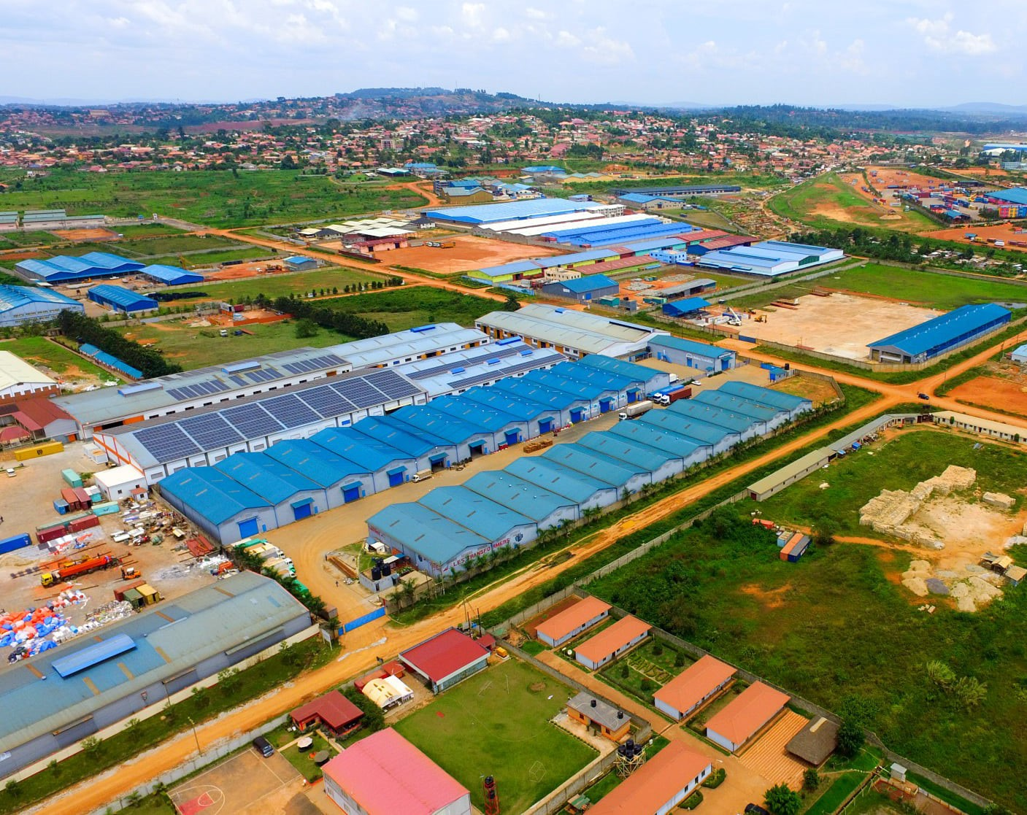


Human Capital Development
100% tax allowable on training costs and research.
Industrial Park
10 Year Tax holiday on income derived for letting out facilities of Industrial Park.

Slide 18
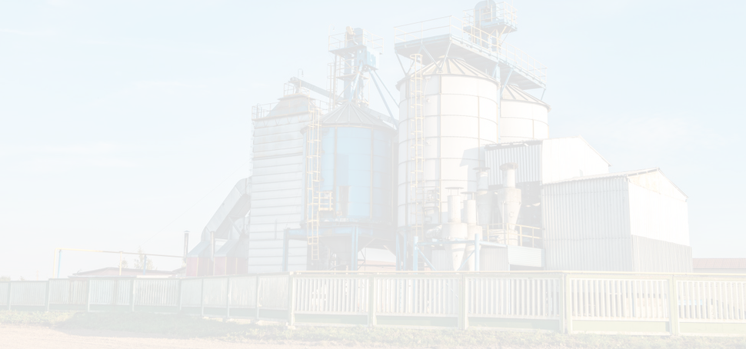



Non -Tax Icentives
Securing land for industrial development.
Securing land for agricultural development (Commercial farming and value addition).
Provide policy advocacy to investors to support investment decision.
02
03
01
Facilitate investors to access infrastructure development in the Industrial parks.

Slide 19
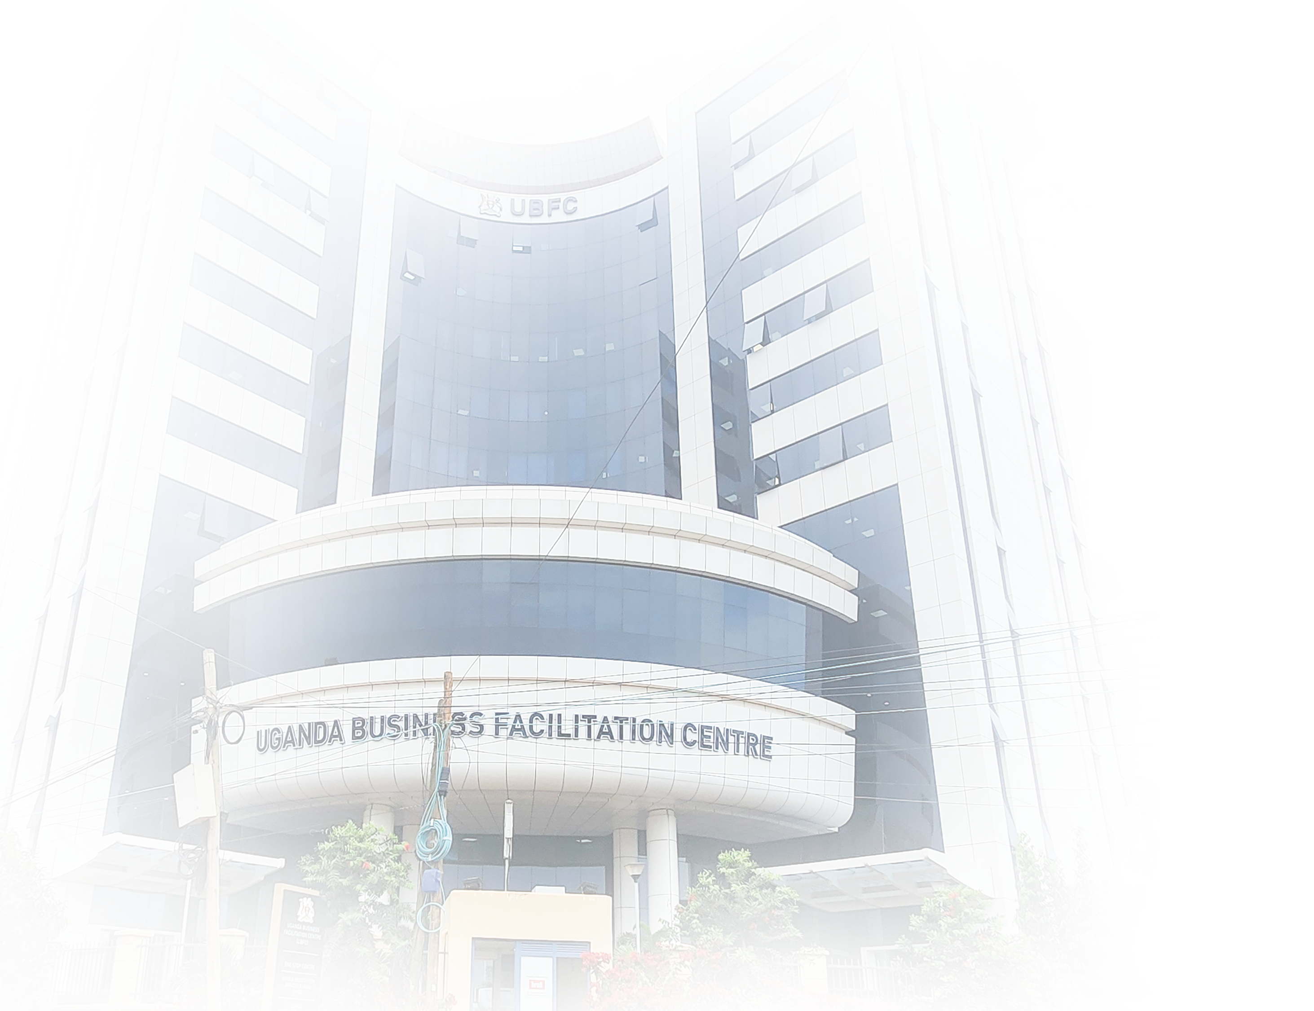














UIA One Stop Centre Services
DCIC
NSSF
Capital Markets
Standards Certification
Trade Registration
& Building approval In Kampala
Business
Registration
Free Zones & Export promotions
Environment Advice
& Compliance
Uganda Investment Authority (Investment,promotion
,facilitation and monitoring)
Lands verification (Lands Registry)
Tax Advisory & Registration
Tourism
Banking Facilities
Utility providers
Conservation Tourism opportunities

Slide 20
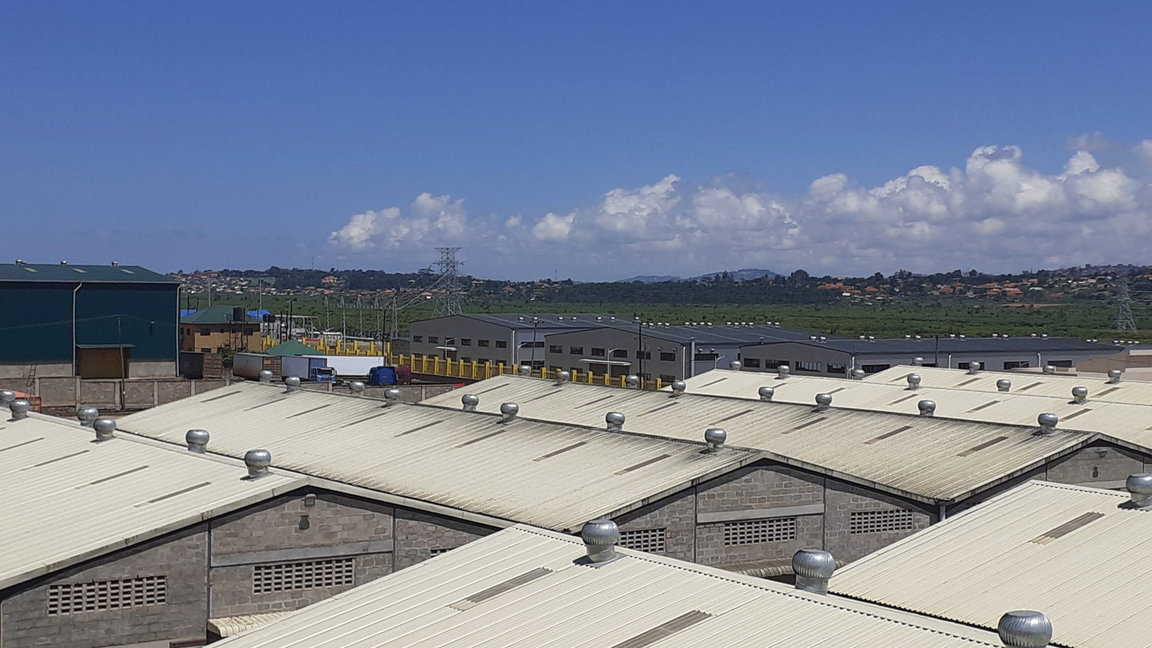

SCAN QR CODE
To access all available projects

Slide 21


THANK YOU!
“
+256 41 4301000
info@ugandainvest.go.ug
www.ugandainvest.go.ug

