Slide 1
EGYPTIAN AFRICAN BUSINESSMEN’S ASSOCIATION
3RD AFRICAN AGRICULTURE DAY
IMPORTANCE OF MODERN AGRICULTURE IN AFRICA
Presented by: Vinay Kanhye
www.kanhyemoringahealth.org
Kanhye moringa
Country: Mauritius

Slide 2
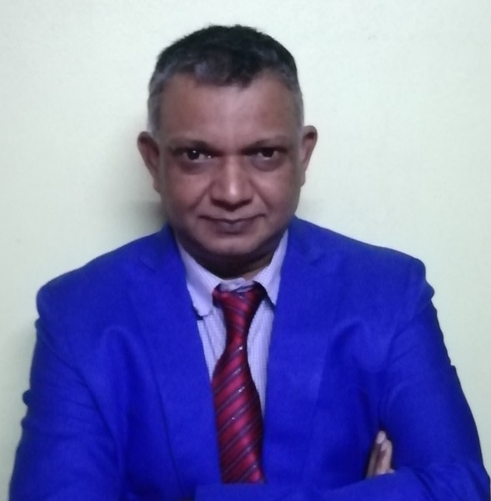
VINAY KANHYE
Electrical and Electronic Engineer
Passionate of plants and natural products
London visit 2012 –first contact with Moringa
The Moringa Adventure and VKHF

Slide 3
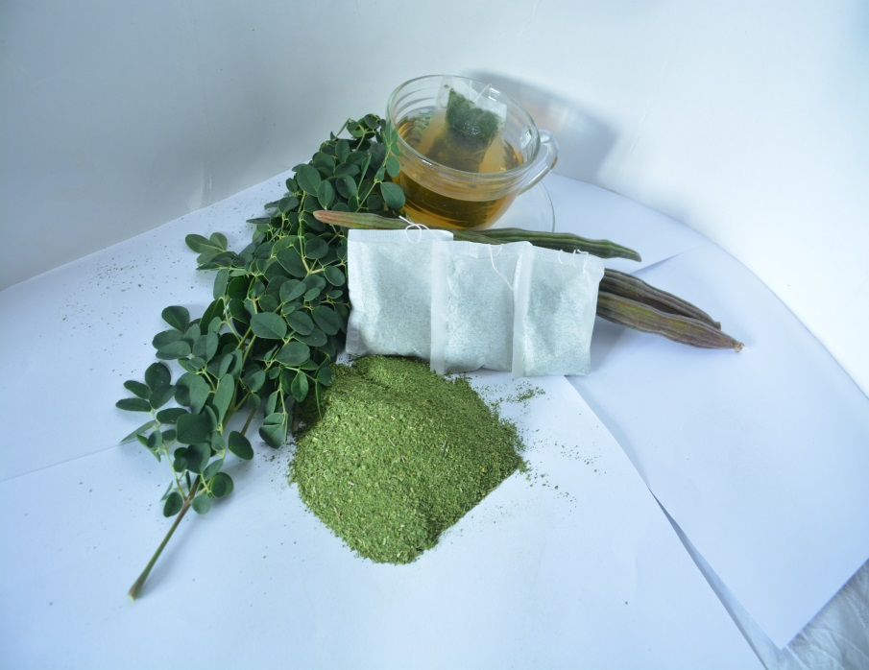
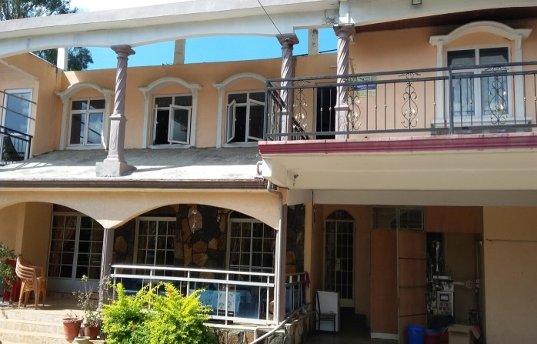
V KANHYE HEALTH FOODS CO LTD
Pioneer commercial grower and producer of moringa products in Mauritius
Started processing of moringa leaves into moringa infusion and powder since June 2015
Since 2017, we are also growing and processing lemongrass and pomegranate
Promoting sustainable agricultural practices and is certified Organic by ECOCERT
Pure and Natural Products

Slide 4
Vision
Vision: An Innovative company growing both locally & internationally
Mission: Provide a natural health product for the benefit of all
Values: Achievement, putting client first, Teamwork, Creativity, Efficiency, Quality
General Strategy: Operational Excellence with Product Leadership

Slide 5
MORINGA- The Miracle Plant

Slide 6
NUTRACEUTICALS – nutrition and pharmaceuticals
Definition | Food and Beverages that provide medical and health benefits including prevention and treatment of diseases
Annual Global Turnover 2019 | US$ 241 billion
Expected Annual Growth Rate till 2026 | 8%
Reasons | Rising trend for prevention through natural products
UOM-EDB Study 2019 | Moringa has the highest Nutraceutical potential

Slide 7
Infusion Tea
Food Supplement
Nutraceuticals

Slide 8
OUR CLIENTS
Supermarkets, Hotels and Spa Mauritius, Duty Free Shop at the airport, Pharmacies
Direct customers through ecommerce
Tea Factory –for making moringa tea
Exports to Canada, Uk, France, Australia

Slide 9
Sustainability
Expansion of Points of sales and e-commerce
Interactive website, enhanced Social media and ecommerce
Product innovation and diversification- Nutraceuticals and Cosmetics
Process Innovation to save on time, water , energy. labour
Use of Eco-friendly packaging – reduction in plastic
Automation and modernised factory
Optimum use of natural lights, natural ventilation in factory
Byproducts use for composting
Washwater re-use for irrigation
Efficient Processing techniques to save on motion and activity
Training of personnel

Slide 10
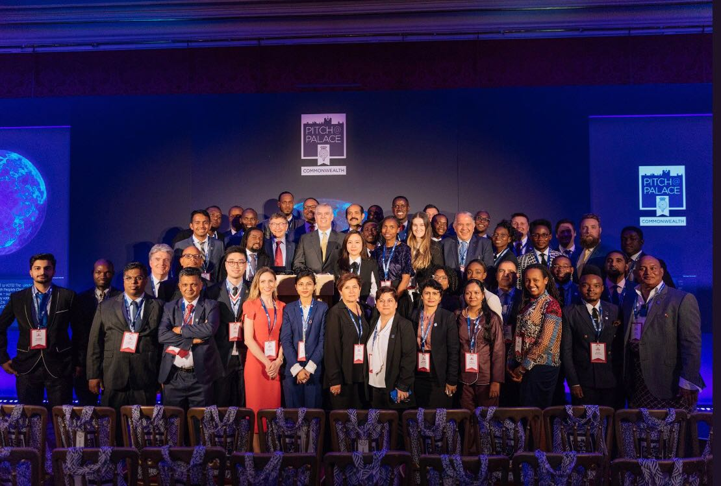
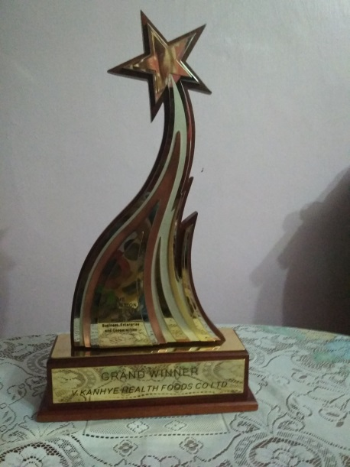
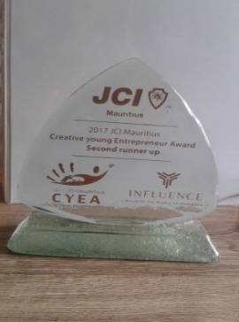
Achievements
Consistent growth
Exports (Promote Mauritian Products)
Top 7 for Verde Scale up competition 2017
Grand Winner SME Innovation Award 2017
Selected to represent Mauritius and pitch at St James Palace for the Pitch@Palace Commonwealth 2018
Grand Winner National Productivity and Competitiveness Council 2018
Gold Award Winner for the International Convention on Quality Control Circle Singapore 2018
Labelled Made in Moris
Awarded Top 15 Southern and Eastern African SME by the GIZ-Germany 2021 Export Promotion Program
Awarded Top 20 Southern and Eastern African SME by Bond Innov Paris under the Enrich in Africa Project 2021
COMESA Innovation Award 2021

Slide 11
COVID 19 Pandemic Impact on SME
Workforce affected as there was panic and lockdown
Reduction in cash flow due to sales drop
Job losses due to shutdown and lockdown
Shortage and price increase of raw materials
Depreciation of the Mauritian Rupee

Slide 12
COMING OUT OF THE C-19
Use of efficient resources water and energy
Adopt good and Modern Agricultural Practices
Develop a resilience plan
Adopt a lean management

Slide 13
IMPORTANCE OF MODERN AGRICULTURE IN AFRICA
Community Involvement through Contract Farming
Job Creation
Environment protection through organic cultivation
Producing a pure and natural product
Ensure Sustainability by planting more trees
By products send back to the fields for mulching and composting
Process wash water recycled for irrigation

Slide 14
CONCLUSION
The Covid-19 pandemic has obliged the business community ,SME in particular, to rethink and remodel the business so as to ensure the survival in the immediate future and work out on strategies for the long term. As is now, it seems that the Economy will take at least two more years to come back to what it was before the pandemic.
It is more crucial to have a plan to ensure the survival during this time of crisis and a longer strategic plan to ensure growth and sustainability when things will start to become normal.
A Modern agricultural practice will help Africa to come out of the effect of the pandemic sooner.

Slide 15
OUR WISH
Consume Healthy
& Stay Healthy
Thank you

