Slide 1
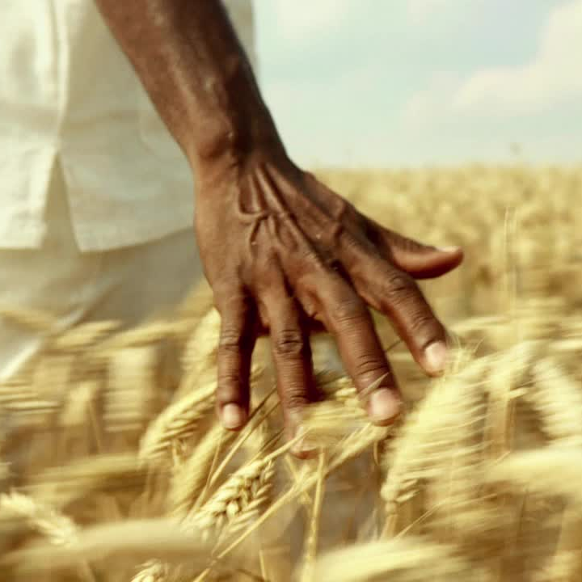
The Importance of Modernized Agriculture in Africa
By
Dr Zakaria Issahaku
Senior Technical Specialist-Market System
MEDA

Slide 2
The Importance of Modernized Agriculture in Africa
Introduction /Brief overview of the topic
Statistics of Agriculture
Benefits of modernized agriculture
Challenges

Slide 3
Statistics on the current state of agriculture in Africa
Agriculture is a critical sector in Africa, providing employment to about 60% of the population and contributing to 15% of the continent's gross domestic product (GDP). (World Bank, 2021)
1
Despite its importance, African agriculture lags behind other regions in terms of productivity. The average yield of major crops in Africa is only 1.8 tons per hectare, compared to a global average of 3.9 tons per hectare. (FAO, 2019)
2
Climate change is a major threat to African agriculture, with many regions experiencing increased droughts, floods, and pests. By 2050, it is estimated that climate change could cause crop yields in Africa to decline by up to 15%. (World Bank, 2021)
3
Smallholder farmers are the backbone of African agriculture, with 80% of all farms in Africa being less than 2 hectares in size. However, these farmers face many challenges, including limited access to finance, markets, and technology. (World Bank, 2021)
4
Africa has the potential to be a major food exporter, but currently, it is a net importer of food, with annual food imports costing about $35 billion. (African Development Bank, 2019)
5
Overall, these statistics highlight the challenges and opportunities facing African agriculture, and the need for investment and innovation to modernize the sector and improve the livelihoods of African farmers
6

Slide 4
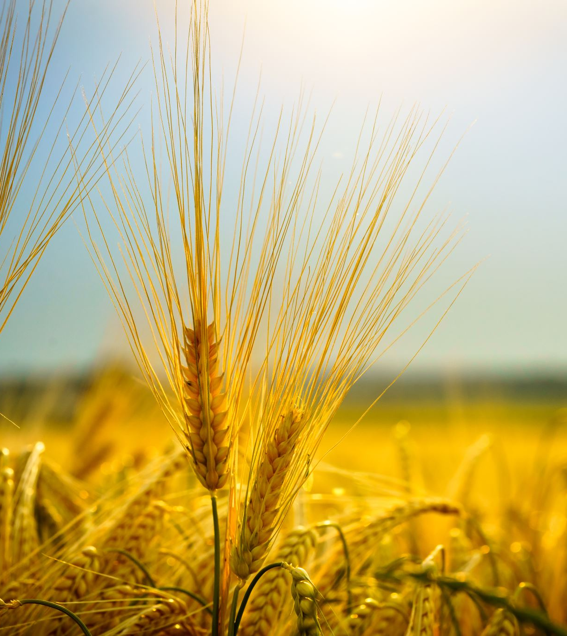
Benefits of Modernized Agriculture
Increased productivity and efficiency: New agricultural technologies, such as precision farming, can help farmers optimize their use of resources and inputs, resulting in higher yields and reduced costs.
Improved crop yields and quality: Technologies such as genetically modified crops and improved seed varieties can increase crop yields and improve their nutritional value, making them more profitable for farmers and better for consumers.
Reduced reliance on traditional farming methods: New technologies such as drip irrigation and hydroponics can help farmers grow crops in areas with limited water and arable land, reducing the dependence on traditional farming methods.
Greater food security and self-sufficiency: By increasing agricultural productivity, new technologies can help reduce food insecurity and dependence on food imports, improving food security and self-sufficiency in local communities.
Opportunities for economic growth and job creation: Modernizing agriculture can create new job opportunities, especially for young people, and contribute to economic growth in rural areas

Slide 5
Technologies/Innovations in Modernized Agriculture
Precision Farming: Precision farming uses technology such as GPS, sensors, and drones to optimize the use of resources and inputs such as water, fertilizers, and pesticides. This can lead to higher yields, reduced costs, and improved environmental sustainability.
Biotechnology: Biotechnology refers to the use of living organisms or their products to improve crop yields, resistance to pests and diseases, and nutritional quality. Examples include genetically modified crops, biopesticides, and biofertilizers.
Digital Tools: Digital tools such as mobile apps, farm management software, and remote monitoring systems can help farmers optimize their operations and make data-driven decisions. For example, the FarmGrow app developed by the International Maize and Wheat Improvement Center (CIMMYT) provides weather forecasts, crop recommendations, and market information to farmers in Africa.
Hydroponics: Hydroponics is a method of growing crops without soil, using water and nutrient solutions instead. Hydroponics can be used to grow crops in areas with limited arable land or water resources and can lead to higher yields and faster crop cycles.
Climate-Smart Agriculture: Climate-smart agriculture refers to agricultural practices that are adapted to the impacts of climate change, reduce greenhouse gas emissions, and improve the resilience of agricultural systems. Examples include agroforestry, conservation agriculture, and crop diversification.
Robotics: Robotics can be used in agriculture to automate tasks such as planting, harvesting, and weeding. This can help reduce labor costs and improve efficiency, especially in areas with labor shortages.
Blockchain: Blockchain technology can be used to track and trace agricultural products from farm to fork, improving transparency, accountability, and food safety. For example, the Provenance platform uses blockchain to track the origin, quality, and sustainability of seafood products.
Overall, these technologies and innovations have the potential to improve the efficiency, productivity, and sustainability of agriculture, leading to better livelihoods for farmers and improved food security for consumers.

Slide 6
Potential challenges associated with new agricultural technologies:
High costs: Many new agricultural technologies require significant investment in research and development, equipment, and training, which can be a barrier to adoption for small-scale farmers.
1
Limited access to technology: Many small-scale farmers in developing countries lack access to the latest agricultural technologies due to limited infrastructure, knowledge, and financing.
2
Environmental concerns: Some new agricultural technologies, such as genetically modified crops, can have unintended environmental consequences, such as the development of pesticide-resistant insects or the contamination of non-GMO crops.
3
Social concerns: New agricultural technologies can also raise social concerns, such as the displacement of small-scale farmers or the concentration of power and resources in the hands of a few large agribusinesses.
4
Lack of regulation and oversight: The rapid pace of technological development can sometimes outpace regulatory and oversight frameworks, which can create risks for food safety, environmental sustainability, and social equity.
5
Overall, new agricultural technologies have the potential to bring significant benefits to farmers and consumers, but their adoption and implementation need to be carefully managed to address these potential challenges and ensure that they are sustainable, equitable, and beneficial for all stakeholders.
6

Slide 7
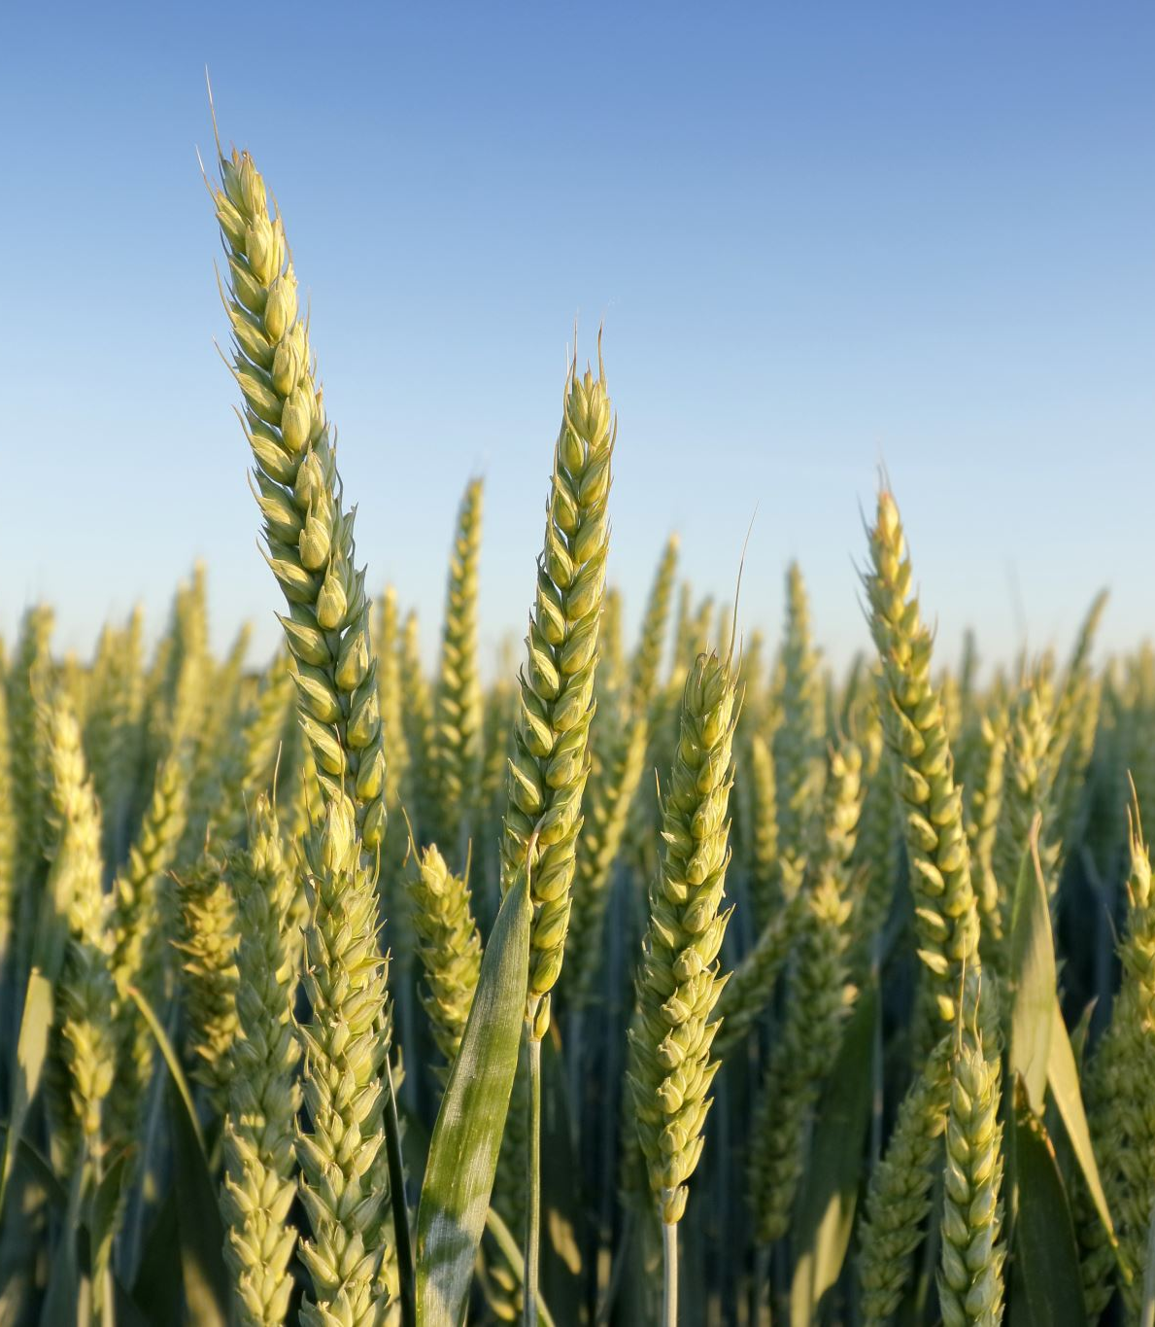
Government Support and Investment
Importance of government support and investment in modernizing agriculture in Africa
Examples of government initiatives and policies that promote modernized agriculture

Slide 8
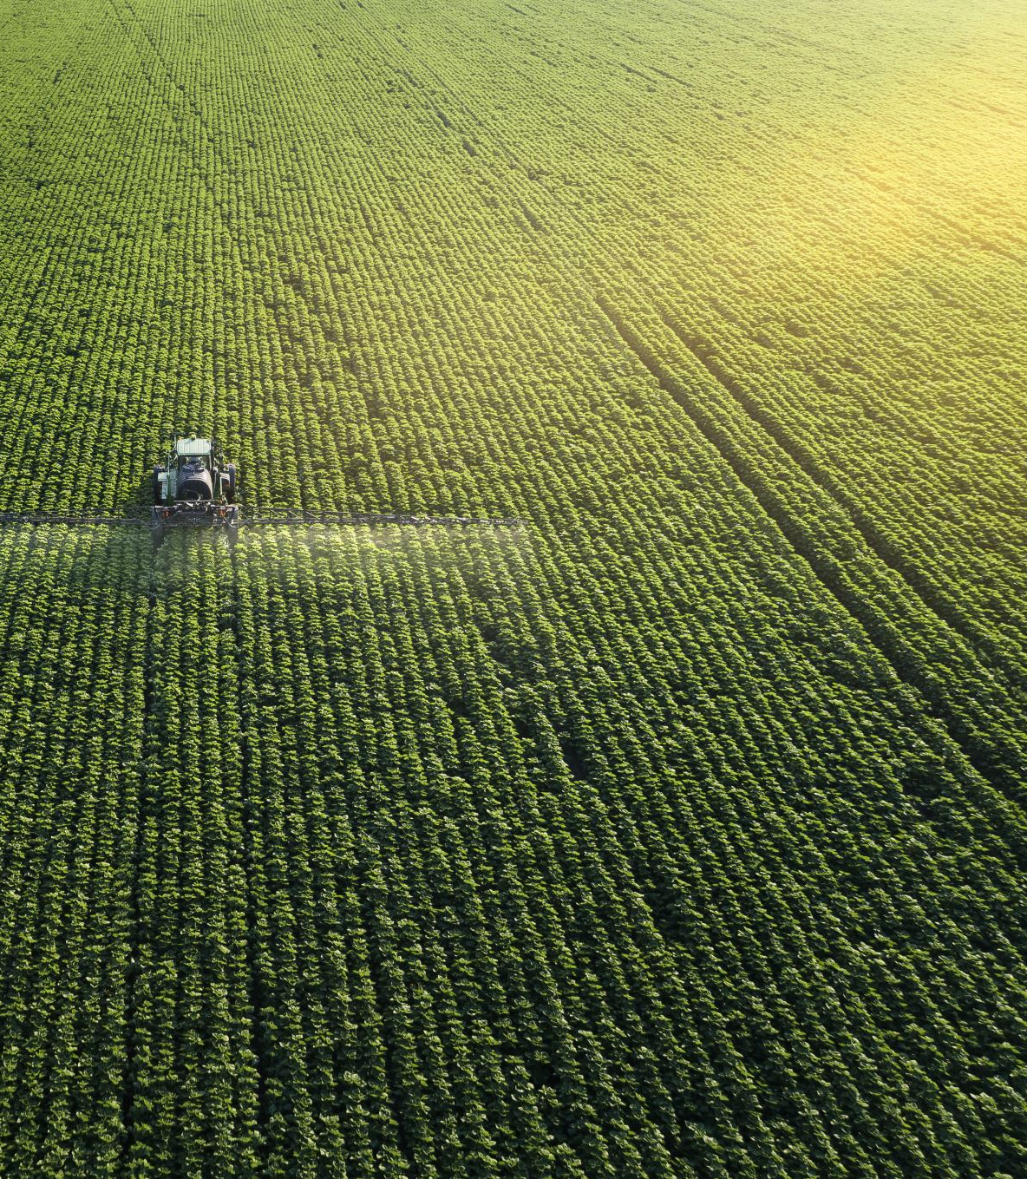
Private Sector Involvement
Importance of private sector involvement in modernizing agriculture in Africa
Examples of private sector initiatives and partnerships that support modernized agriculture

Slide 9
Case Study: Successful Implementation of Modernized Agriculture in Africa
Example of a successful implementation of modernized agriculture in Africa, such as the IWAD in Ghana
Explanation of the project and its impact on farmers and the local community

Slide 10
Conclusions
Benefits of modernized agriculture in Africa.
Need for increased support and investment in modernizing agriculture in Africa
Regenerative agriculture
Access to finance
Agro processing
Triple impact-food systems
Address land security issues

